Slide 1
Ribosomes
Ribosomes facilitate specific coupling of tRNA anticodons with mRNA codons in protein synthesis
The two ribosomal subunits (large and small) are made of proteins and ribosomal RNA (rRNA)
Bacterial and eukaryotic ribosomes are somewhat similar but have significant differences: some antibiotic drugs specifically target bacterial ribosomes without harming eukaryotic ribosomes

Slide 2
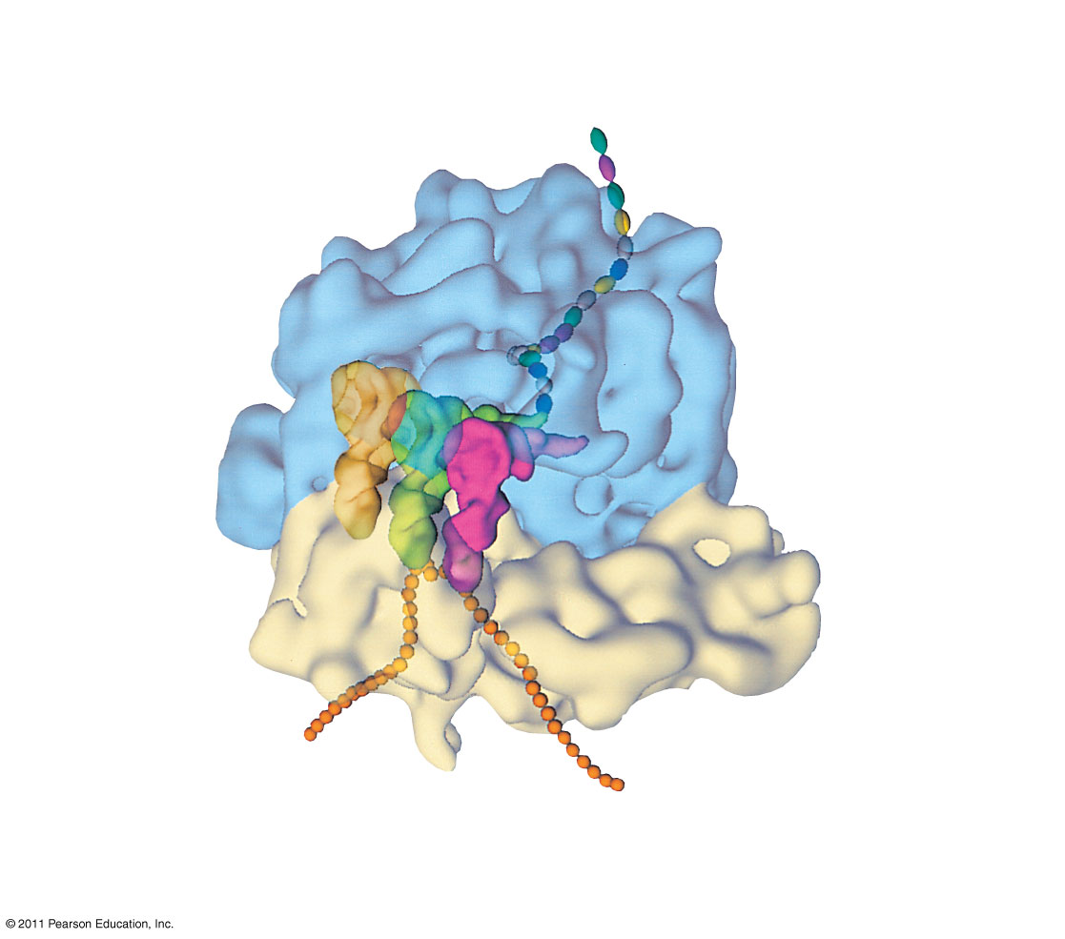
Figure 17.17a
Growing polypeptide
Exit tunnel
tRNA molecules
Large subunit
E
P
A
Small subunit
5′
mRNA
3′
(a) Computer model of functioning ribosome
Notes:
Figure 17.17 The anatomy of a functioning ribosome.

Slide 3
Figure 17.17b
P site (Peptidyl-tRNA binding site)
Exit tunnel
A site (Aminoacyl- tRNA binding site)
E site (Exit site)
E
P
A
Large subunit
mRNA binding site
Small subunit
(b) Schematic model showing binding sites
Notes:
Figure 17.17 The anatomy of a functioning ribosome.

Slide 4
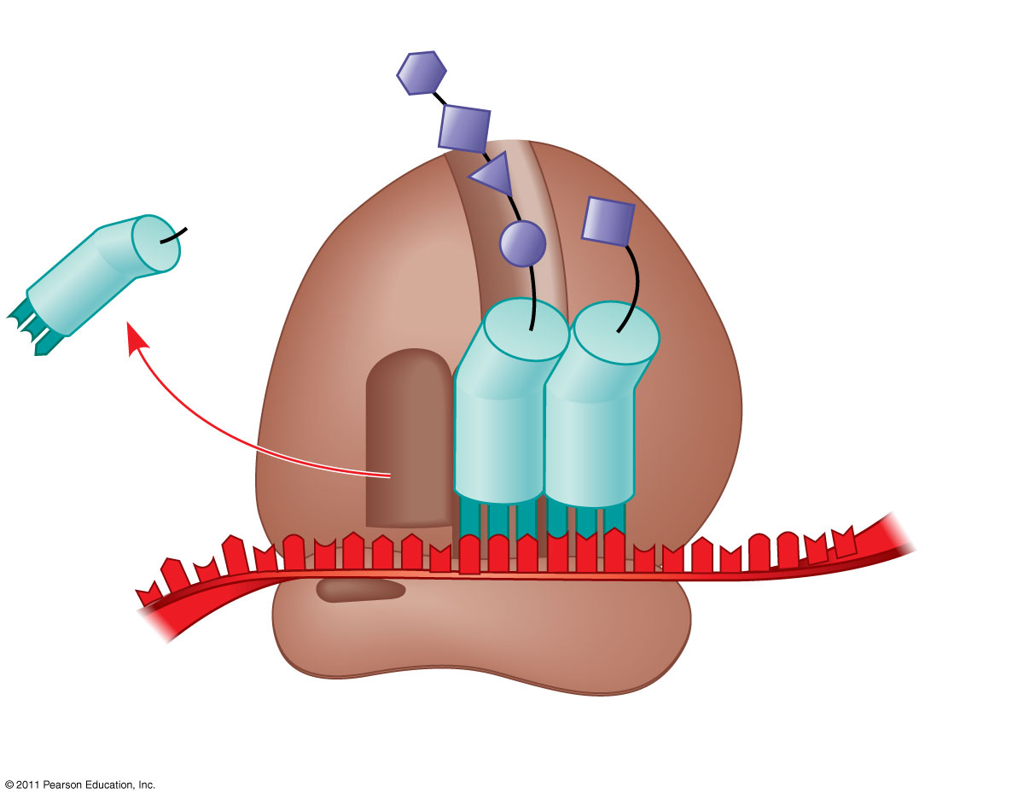
Figure 17.17c
Growing polypeptide
Amino end
Next amino acid to be added to polypeptide chain
E
tRNA
mRNA
3′
5′
Codons
(c) Schematic model with mRNA and tRNA
Notes:
Figure 17.17 The anatomy of a functioning ribosome.

Slide 5
A ribosome has three binding sites for tRNA
The P site holds the tRNA that carries the growing polypeptide chain
The A site holds the tRNA that carries the next amino acid to be added to the chain
The E site is the exit site, where discharged tRNAs leave the ribosome

Slide 6
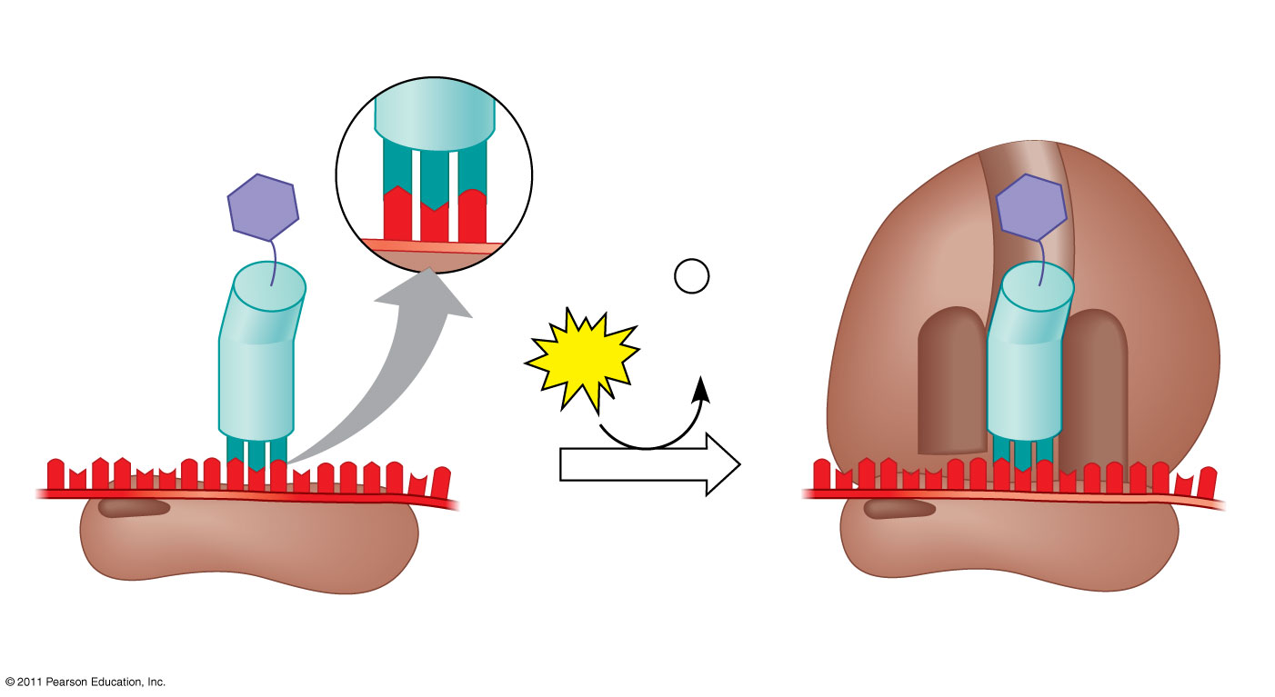
Figure 17.18
Large ribosomal subunit
3′
U
A
C
5′
P site
Met
5′
A
U
G
3′
Met
P
i
Initiator tRNA
+
GTP
GDP
E
A
mRNA
5′
5′
3′
3′
Start codon
Small ribosomal subunit
mRNA binding site
Translation initiation complex
Notes:
Figure 17.18 The initiation of translation.

Slide 7
During the elongation stage, amino acids are added one by one to the preceding amino acid at the C-terminus of the growing chain
Each addition involves proteins called elongation factors and occurs in three steps: codon recognition, peptide bond formation, and translocation
Translation proceeds along the mRNA in a 5′ to 3′ direction

Slide 8
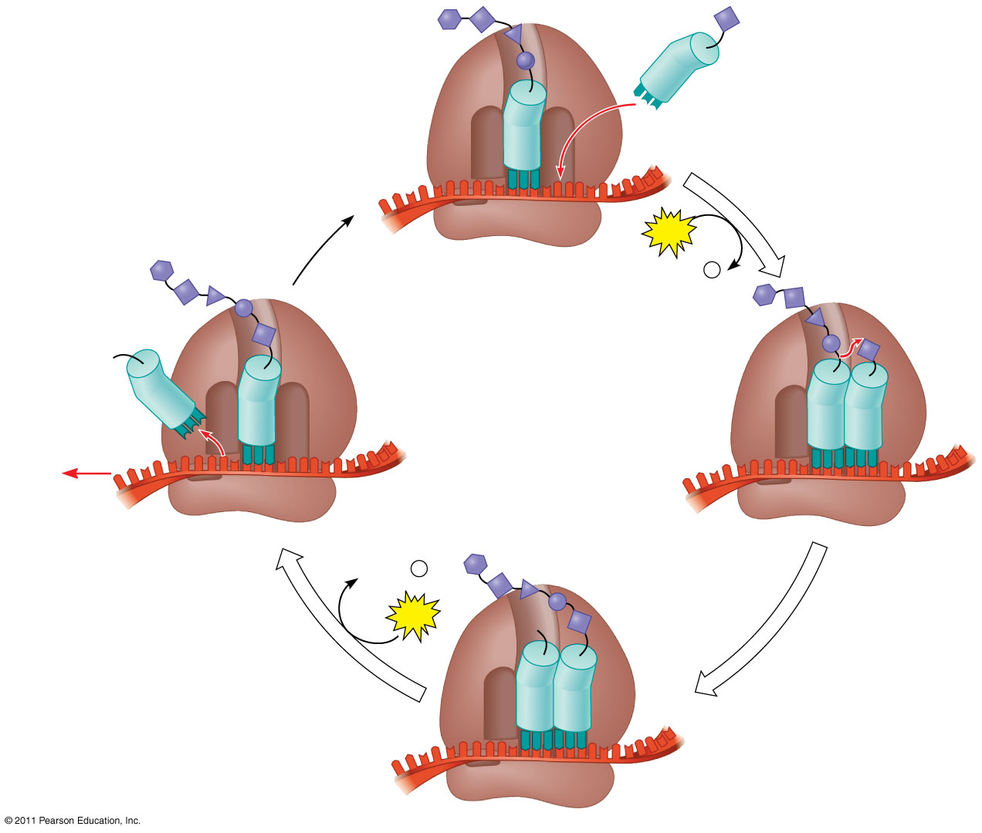
Figure 17.19-4
Amino end of polypeptide
E
3′
mRNA
Ribosome ready for next aminoacyl tRNA
P site
A site
5′
GTP
GDP
+
P
i
E
E
P
A
P
A
GDP
+
P
i
GTP
E
P
A
Notes:
Figure 17.19 The elongation cycle of translation.

Slide 9
Termination occurs when a stop codon in the mRNA reaches the A site of the ribosome
The A site accepts a protein called a release factor
The release factor causes the addition of a water molecule instead of an amino acid
This reaction releases the polypeptide, and the translation assembly then comes apart

Slide 10
Figure 17.20-3
Release factor
Free polypeptide
5′
3′
3′
5′
5′
2
GTP
3′
Stop codon
2
GDP
+
2
P
i
(UAG, UAA, or UGA)
Notes:
Figure 17.20 The termination of translation.

Slide 11
A number of ribosomes can translate a single mRNA simultaneously, forming a polyribosome (or polysome)
Polyribosomes enable a cell to make many copies of a polypeptide very quickly

Slide 12
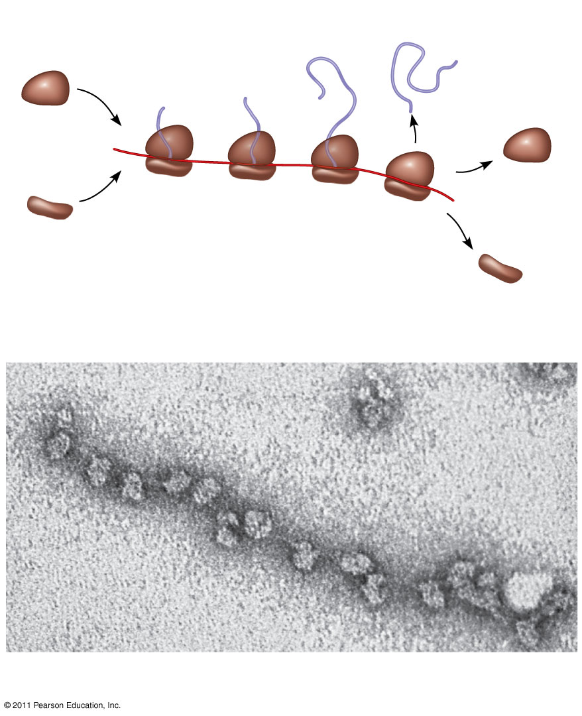
Figure 17.21
Completed polypeptide
Growing polypeptides
Incoming ribosomal subunits
Polyribosome
Start of mRNA (5′ end)
End of mRNA (3′ end)
(a)
Ribosomes
mRNA
(b)
0.1 μm
Notes:
Figure 17.21 Polyribosomes.

Slide 13
Completing and Targeting the Functional Protein
Often translation is not sufficient to make a functional protein
Polypeptide chains are modified after translation or targeted to specific sites in the cell

Slide 14
Protein Folding and Post-Translational Modifications
During and after synthesis, a polypeptide chain spontaneously coils and folds into its three-dimensional shape
Proteins may also require post-translational modifications before doing their job
Some polypeptides are activated by enzymes that cleave them
Other polypeptides come together to form the subunits of a protein

Slide 15
Two populations of ribosomes are evident in cells: free ribsomes (in the cytosol) and bound ribosomes (attached to the ER)
Free ribosomes mostly synthesize proteins that function in the cytosol
Bound ribosomes make proteins of the endomembrane system and proteins that are secreted from the cell
Ribosomes are identical and can switch from free to bound

Slide 16
Polypeptide synthesis always begins in the cytosol
Synthesis finishes in the cytosol unless the polypeptide signals the ribosome to attach to the ER
Polypeptides destined for the ER or for secretion are marked by a signal peptide

Slide 17
A signal-recognition particle (SRP) binds to the signal peptide
The SRP brings the signal peptide and its ribosome to the ER

Slide 18
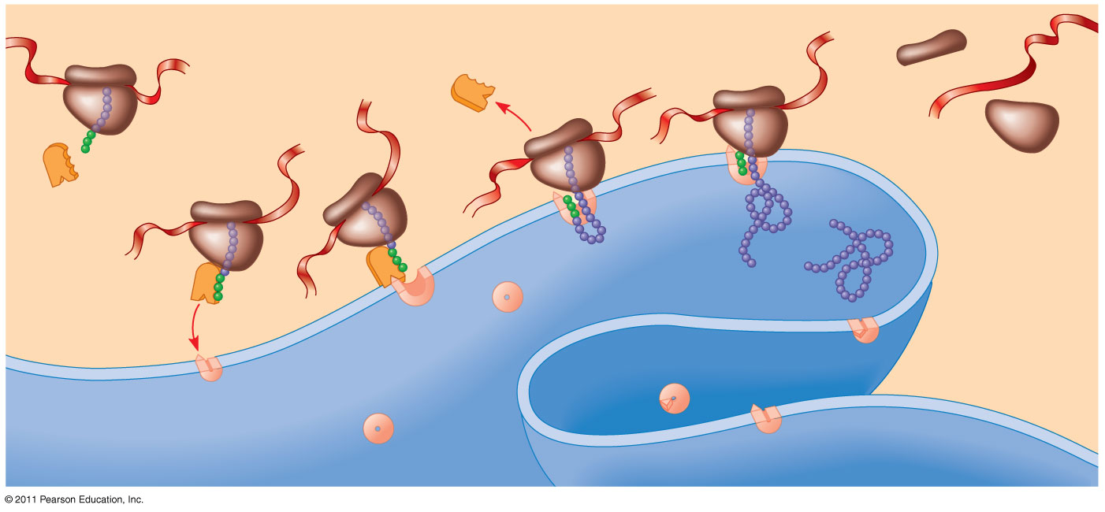
Figure 17.22
1
Ribosome
5
mRNA
4
Signal peptide
ER membrane
3
Signal peptide removed
SRP
Protein
6
2
SRP receptor protein
CYTOSOL
ER LUMEN
Translocation complex
Notes:
Figure 17.22 The signal mechanism for targeting proteins to the ER.

